Slide 1

Flight Fare Prediction
Using
ML Techniques

Slide 2
Objective
This project aims to develop an application which can predict the flight prices for various flights using different machine learning techniques
Airlines utilize different computational methods to extend their income, as an example, demand forecast and value segregation.
The proposed system can help save immeasurable rupees of shoppers by proving them the knowledge to book tickets at the correct time.

Slide 3
Approach (1/2)
we've implemented the machine learning life cycle to make a basic web application which is able to predict the flight fare by applying machine learning algorithms on historical flight data
Using some python libraries like Pandas, NumPy, Matplotlib, seaborn, and sklearn. Below image shows the number of steps that we followed from the life cycle

Slide 4
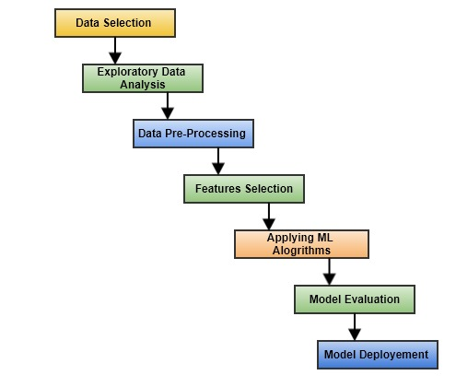
Approach(2/2)
The image shows the number of steps that we followed from the life cycle

Slide 5
Description
Our dataset consists of quite 10,000+ records of information associated with flights and costs. A number of the features of the dataset are source, destination, departure date, point, and number of stops, point in time, prices
Within the exploratory data analysis step, we cleaned the dataset by removing the duplicate values and null values.
If the null values aren't removed, the accuracy of the model are affected.

Slide 6
Dataset Information
Airline: So this column will have all the types of airlines like Indigo, Jet Airways, Air India, and many more.
Date_of_Journey: This column will let us know about the date on which the passenger’s journey will start.
Source: This column holds the name of the place from where the passenger’s journey will start.
Destination: This column holds the name of the place to where passengers wanted to travel.
Route: Here we can know about that what is the route through which passengers have opted to travel from his/her source to their destination.
Arrival_Time: Arrival time is when the passenger will reach his/her destination.
Duration: Duration is the whole period that a flight will take to complete its journey from source to destination.
Total_Stops: This will let us know in how many places flights will stop there for the flight in the whole journey.
Additional_Info: In this column, we will get information about food, kind of food, and other amenities.
Price: Price of the flight for a complete journey including all the expenses before onboarding.

Slide 7
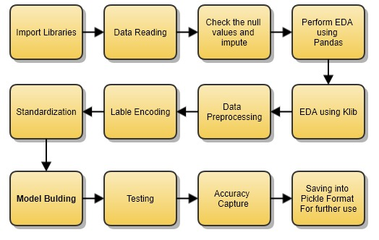
Design Flow (Code Implementation)

Slide 8
Data Pre-Processing steps Performed

Slide 9
Price Analysis w.r.t Destinations
As part of Data cleaning we processed the data as mentioned below
Null Values Handling or Imputation
Date time Conversions & Type Casting
One-Hot Encoding
Label Encoding
New features derivations
Dropping duplicated features by some means. (Ex: After Dummies creation dropping actual feature)

Slide 10
EDA Results & Observations

Slide 11
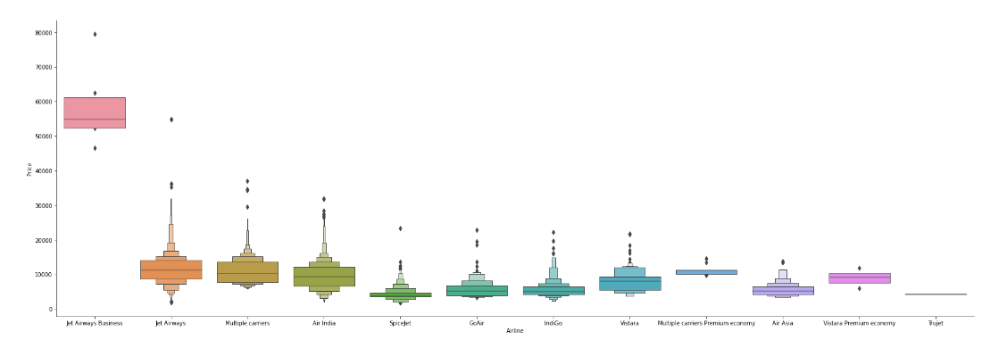
Price Analysis of all Airlines
Inference: Here with the help of the cat plot we are trying to plot the boxplot between the price of the flight and airline and we can conclude that Jet Airways has the most outliers in terms of price.

Slide 12
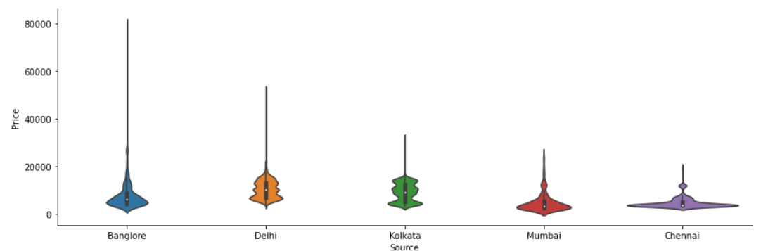
Price Analysis w.r.t Sources
Inference: Now with the help of cat plot only we are plotting a box plot between the price of the flight and the source place i.e. the place from where passengers will travel to the destination and we can see that Bangalore as the source location has the most outliers while Chennai has the least.

Slide 13
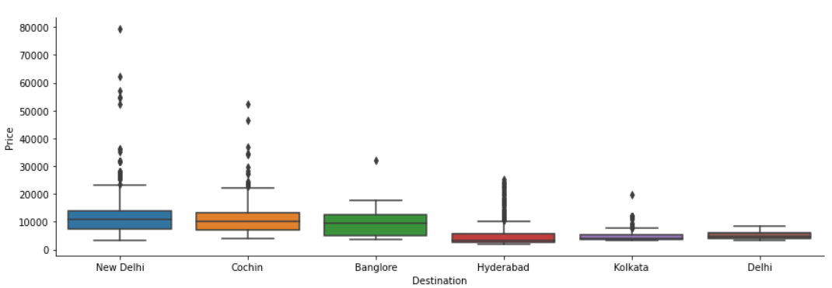
Price Analysis w.r.t Destinations
Inference: Here, we are plotting the box plot with the help of a cat plot between the price of the flight and the destination to which the passenger is travelling and figured out that New Delhi has the most outliers and Kolkata has the least.

Slide 14
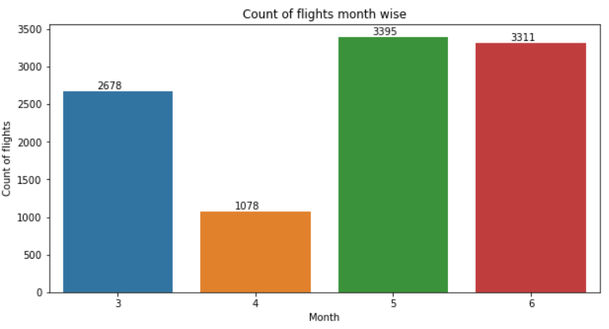
Monthly Distribution
Inference: Here in the above graph we have plotted the count plot for journey in a month vs several flights and got to see that May has the most number of flights.

Slide 15
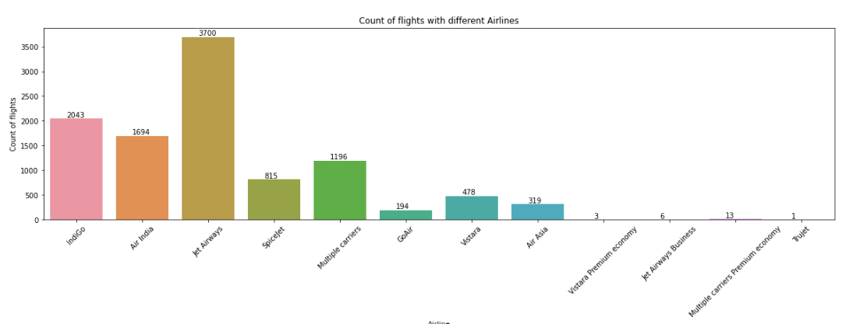
Airlines Distribution
Inference: Now from the above graph we can see that between the type of airline and count of flights we can see that Jet Airways has the most flight boarded.

Slide 16
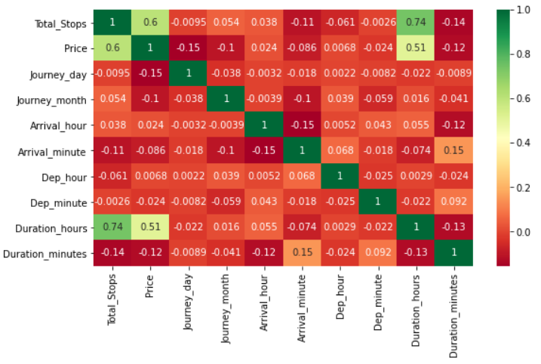
Correlation Analysis

Slide 17
Final Outcome
We had used many algorithms for prepared our ML model i.e., Linear Regression, Decision tree, Random Forest.
From all of these, Random Forest gives us the most accurate Predictions. Models' performance using a few metrics are given below:
RANDOM FOREST:
R2 SCORE : 0.8598264560438941 (~85%)
MAE : 1164.5042333744152
MSE : 4043823.6841106885
RMSE : 2010.3049101804945

Slide 18
THANK YOU !!

